Slide 1


INDUSTRY BRIEFING
Project Naukri Job Market Trend
Analysis
Name: Dharshan Roy K
StudentID: AF0532182
Batch: ANP-D 7635
Branch: Anudip, Pallavaram

Slide 2

[All pillars]
Indian Tech Jobs Market Insights and Power BI Schema
23,201
postings on the canvas model; 6,944 employers, 6 role categories, 10 state values
Basis: 23,201-row Power BI model (what the canvas shows) unless marked “(de-dup)”. Source: naukri.com scrape, 10 June 2025.
01

Slide 3
[All pillars]
The cleaned layer is a star schema, but reconciliation still has a 52-row open item
CLEANED-LAYER DESIGN
Employer
Experience
6,944 employers
re-derived tiers
Location
Recency
city and state rules
JobPosting
capped recency bucket
21,123 documented de-dup postings
Role
Date
6 role categories
scrape date context
WorkMode
JobSkill
Skill
on-site / hybrid / remote
many-to-many job-skill bridge
lower-cased skills
VISUAL
DQ_Ledger
Visual: star schema plus reconciliation bridge; fields: fact table, 8 dimensions, bridge table, DQ ledger, model rows, documented de-dup rows, open item.
live COUNTIF checks
Basis: 23,201-row Power BI model (what the canvas shows) unless marked “(de-dup)”. Source: naukri.com scrape, 10 June 2025.
02

Slide 4
[Dashboard]
Page 1 leads with 23,201 jobs, but salary and fresher KPIs sit on narrow subsets
23,201
15.32 LPA
11.93%
18.03%
Total Jobs
Avg Benchmark Salary
Disclosed Salary Rate
Fresher Friendly Ratio
Avg Benchmark Salary is the mean midpoint on 2,768 disclosed salaries, not the full 23,201-row canvas.
Disclosed Salary Rate is 11.93%, so salary KPIs describe a disclosed subset.
Fresher Friendly Ratio is 18.03% (4,182 postings) as built on the canvas.
A 30-cell role-by-experience matrix plus donut, pie, funnel, bar, and line charts are carried.
Slicers cover work mode, skill domain, salary tier, company size, and salary range.
DASHBOARD COMPOSITION
Page 1
26
Page 2
11
Page 3
10
47 visuals across 3 pages: 26 / 11 / 10. Bookmarks: Insights, hide insights, Clear Filter.
Basis: 23,201-row Power BI model (what the canvas shows) unless marked “(de-dup)”. Source: naukri.com scrape, 10 June 2025.
03

Slide 5
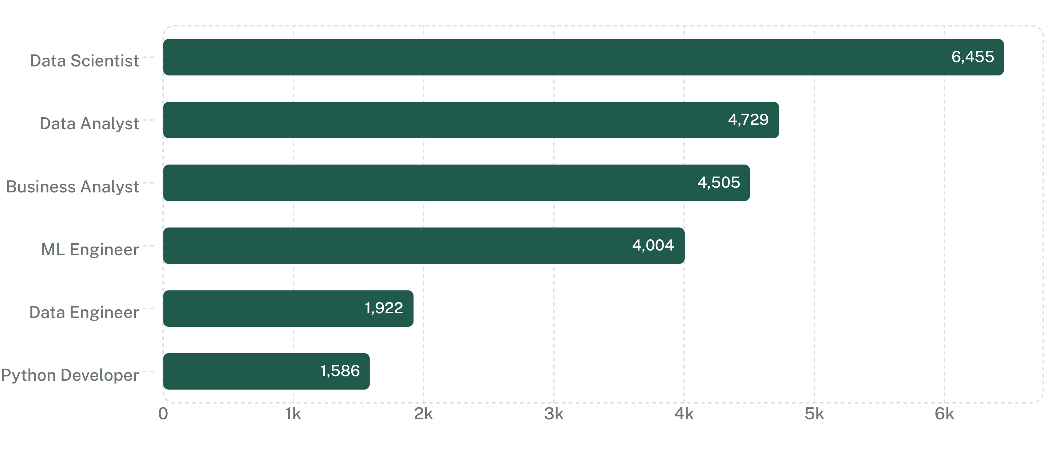
[Dashboard]
The largest matrix cell is Data Scientist × Mid: 3,074 jobs at 17.2 LPA
3,074 jobs
Jobs
Data Scientist × Mid (3-5 Yrs), at 17.2 LPA; Senior (6-8) is 1,547 jobs at 22.5 LPA.
Metric Selector is a field parameter switching 3 metrics: Total Jobs, Avg Benchmark Salary (LPA), Fresher Friendly Ratio.
The model has 8 DAX measures, including Dominant Work Mode and High Rated Jobs = rating 4.0 to <4.5.
Role demand: Data Scientist 6,455; Data Analyst 4,729; Business Analyst 4,505; ML Engineer 4,004; Data Engineer 1,922; Python Developer 1,586.
Experience mix: Mid 43.6%, Junior 21.2%, Senior 20.7%, Fresher 9.6%, Lead/Architect 4.9%.
The full 30-cell role-by-experience matrix is documented; unprinted cell values are [not in source].
MATRIX HIGHLIGHTS
Data Scientist × Mid
Data Scientist × Senior
Data Analyst × Junior
3,074 jobs · 17.2 LPA
1,547 jobs · 22.5 LPA
1,432 jobs · 5.5 LPA
Visual: role bar plus matrix excerpt; fields: role, Total Jobs, experience tier, Avg Benchmark Salary, Metric Selector metrics, DAX measures.
Basis: 23,201-row Power BI model (what the canvas shows) unless marked “(de-dup)”. Source: naukri.com scrape, 10 June 2025.
04

Slide 6
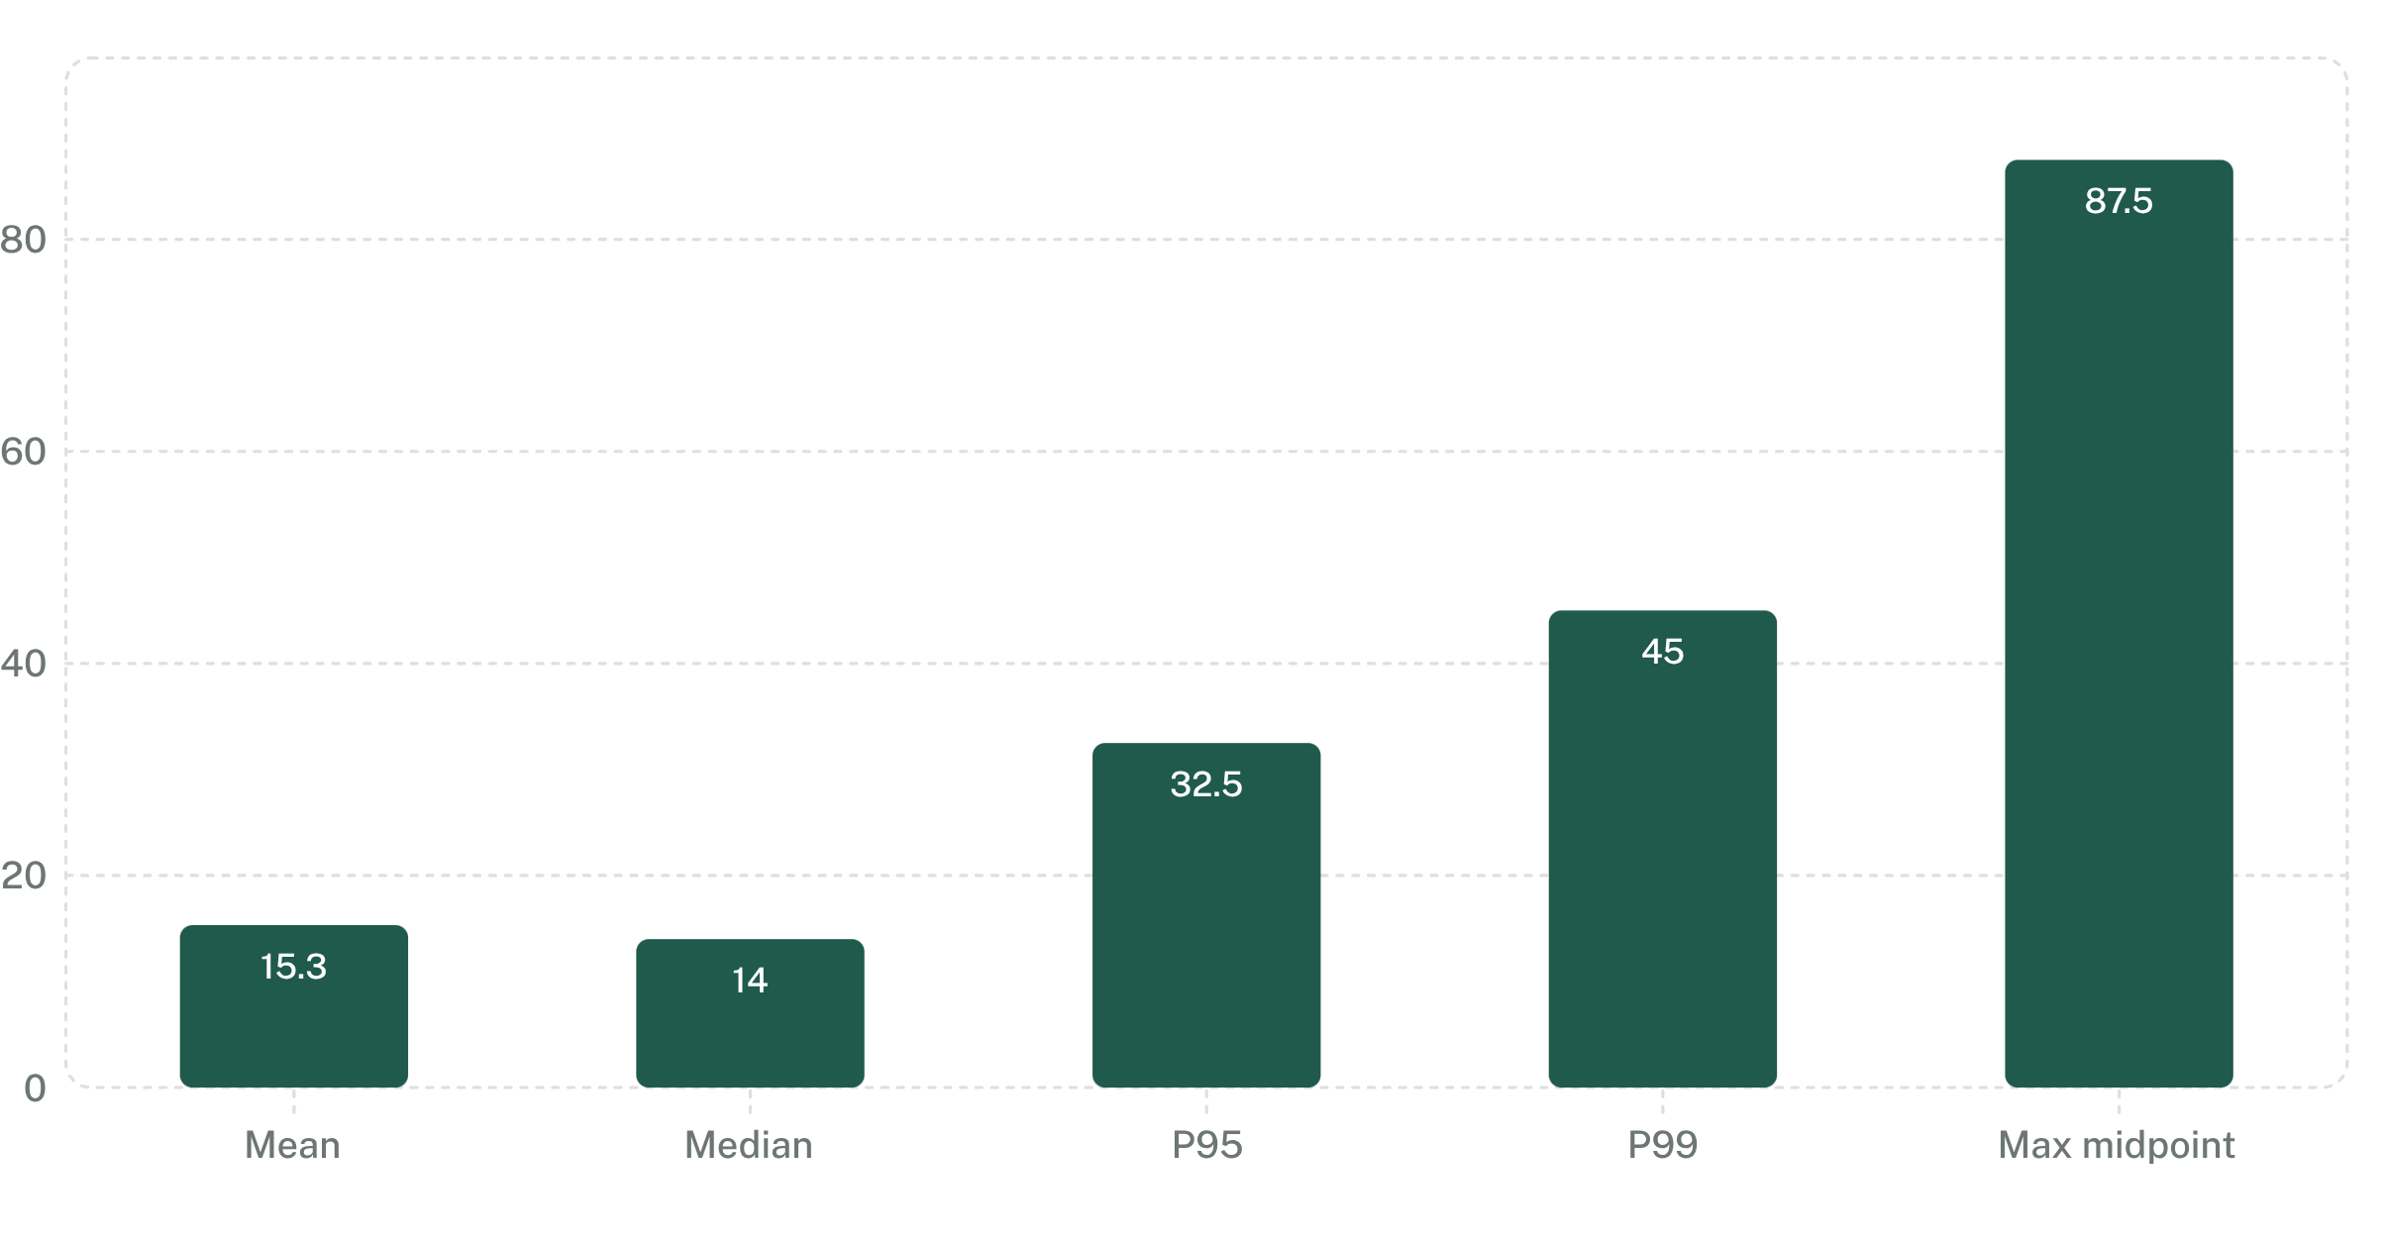
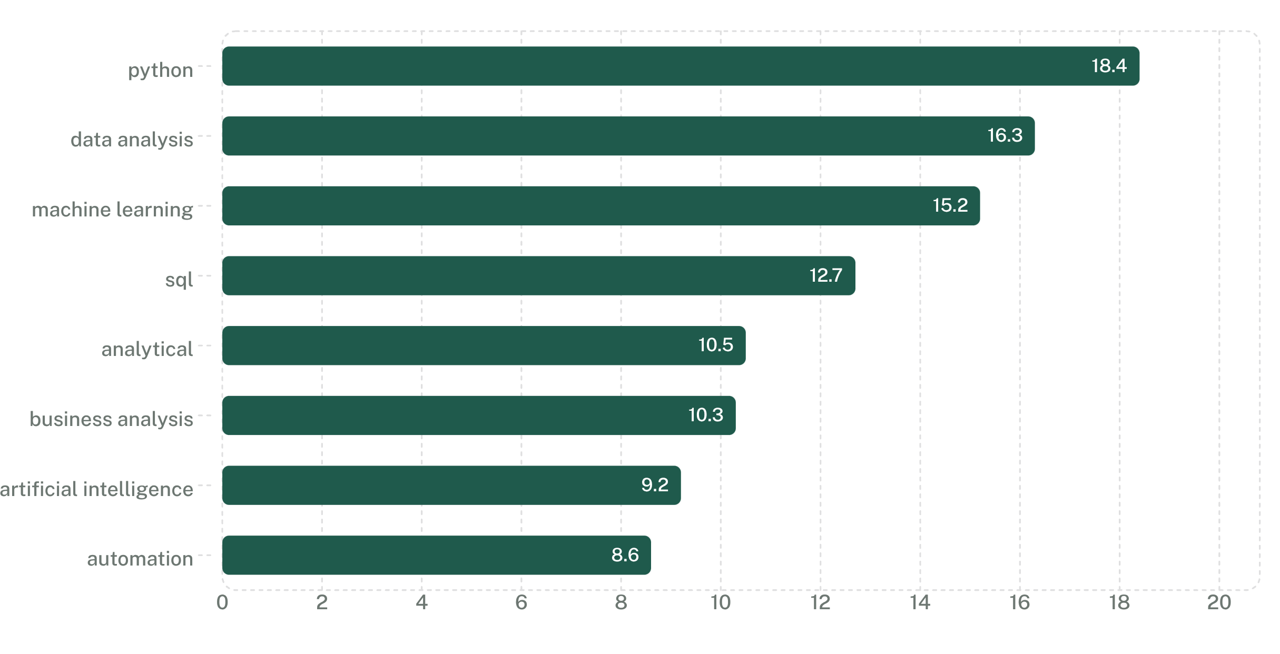
[Dashboard]
Only 11.93% disclose salary, and the disclosed subset is right-skewed
LPA
Share of postings
Salary basis: n=2,768 disclosed rows (11.93%); mean range 11.60 to 19.04 LPA.
Skill domains: Business Intelligence 47.9%, AI/ML/DL 28.4%, Cloud and DevOps 10.1%, Data Engineering 6.9%, Data Science 6.7%.
Salary tiers: Senior 10-20 = 1,201; Leadership 20+ = 463; Junior 3-6 = 463; Mid 6-10 = 329; Entry <3 = 249.
Work-mode premium: Hybrid 21.01 versus Remote 14.49 versus On-site 13.21 LPA; work mode mix is On-site 80.6%, Hybrid 10.1%, Remote 9.3%.
Skills are 10,623 distinct; 547 postings (2.4%) are “Not Available”.
Visual: salary benchmark bars; fields: mean, median, P95, P99, max midpoint, disclosed n.
Basis: 23,201-row Power BI model (what the canvas shows) unless marked “(de-dup)”. Source: naukri.com scrape, 10 June 2025.
05

Slide 7
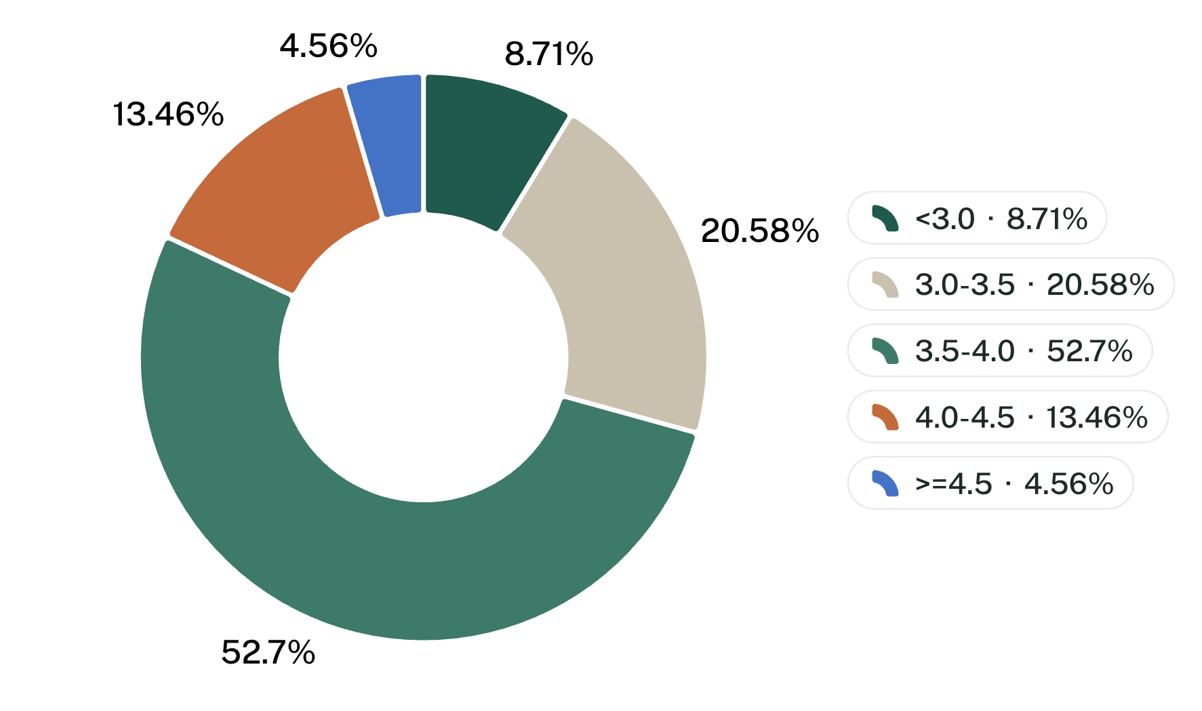
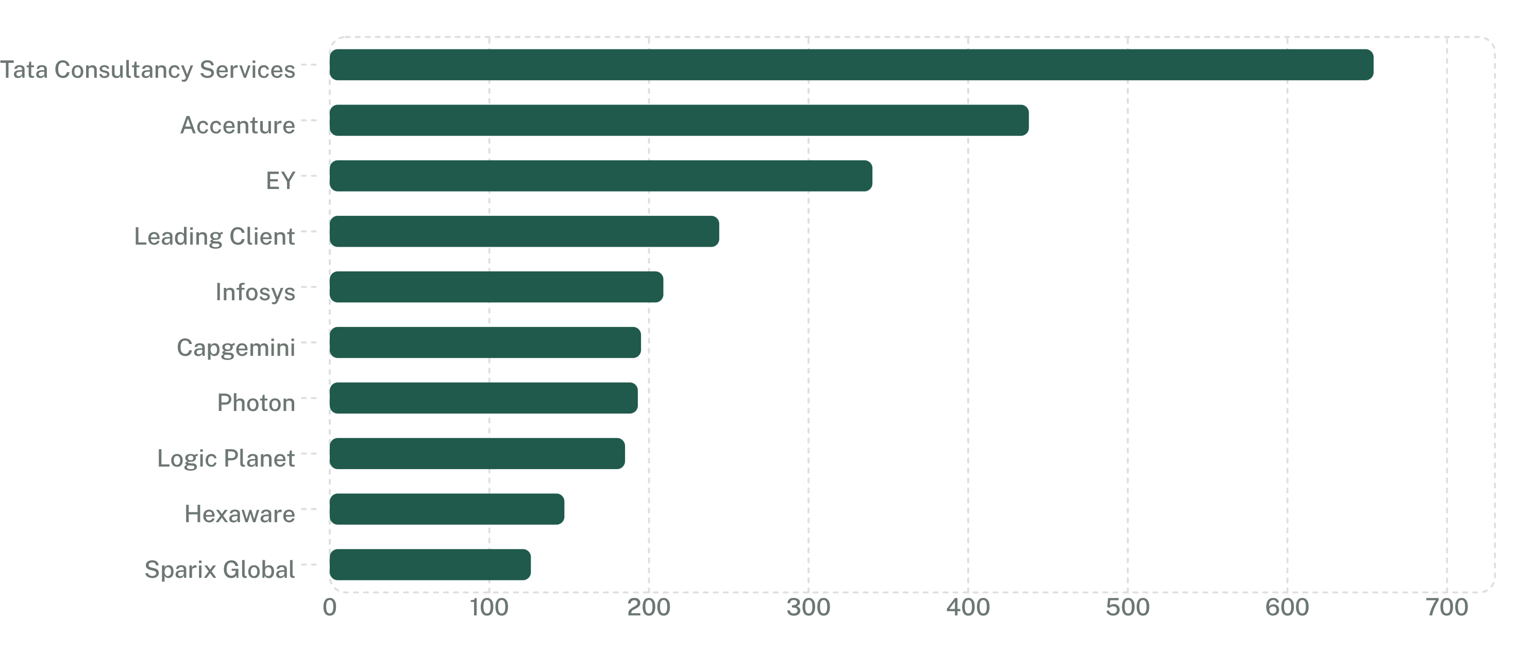
[Company]
4,097 employers post exactly once, so employer concentration is a long-tail market
4,097 employers = 59.0%
Rating band
post exactly once; they account for 17.7% of postings. Top 10 hold 11.8%; top 20 hold 15.9%.
Postings
Median rating is 3.6; 30.7% of postings sit at exactly 3.6.
Largest named employer: Tata Consultancy Services 654; Accenture 438; EY 340.
“Leading Client” appears as an employer with 244 postings.
High Rated Jobs use rating 4.0 to <4.5 in the model’s DAX logic.
Visual: employer bar plus rating-band donut; fields: employer, postings, rating band, postings.
Basis: 23,201-row Power BI model (what the canvas shows) unless marked “(de-dup)”. Source: naukri.com scrape, 10 June 2025.
06

Slide 8
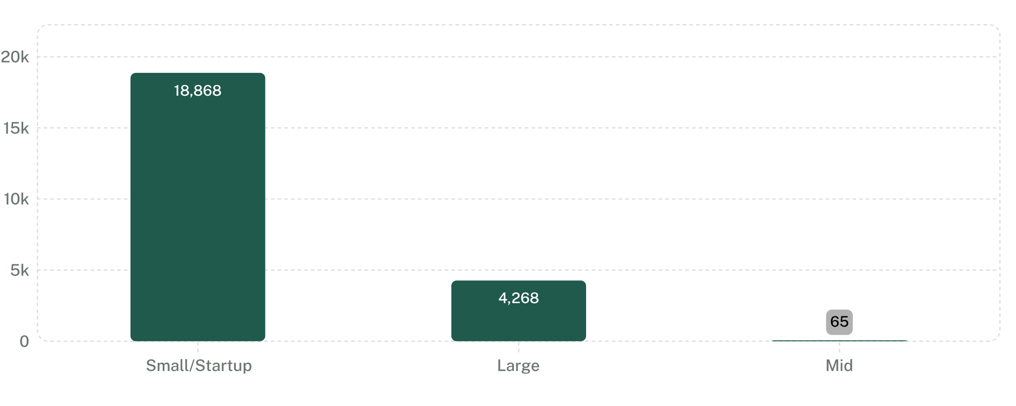
[Company]
18,868 postings sit in Small/Startup, a size bucket driven by heuristic rules
18,868 · 81.3%
ANONYMISATION SIGNALS
are bucketed Small/Startup (<100). Large (1000+) is 4,268 (18.4%); Mid (100-999) is only 65 (0.3%).
244 postings
1.05% · would rank #4
Leading Client
Postings
602 postings
2.59% · 96 generic names
Keyword scan
name heuristic
rule-based flag
IsLikelyAnonymised
The keyword scan uses Leading Client, Client of, Confidential, MNC, and “Service based…”; present it as indicative, not the IsLikelyAnonymised rule.
A3: EY (340), Photon (193), and Nagarro (90) are bucketed Small/Startup.
A6: “Leading Client” still ranks #4 as an employer.
Visual: hiring-tier bars plus anonymisation ledger; fields: size bucket, postings, generic-name scan counts.
Basis: 23,201-row Power BI model (what the canvas shows) unless marked “(de-dup)”. Source: naukri.com scrape, 10 June 2025.
07

Slide 9
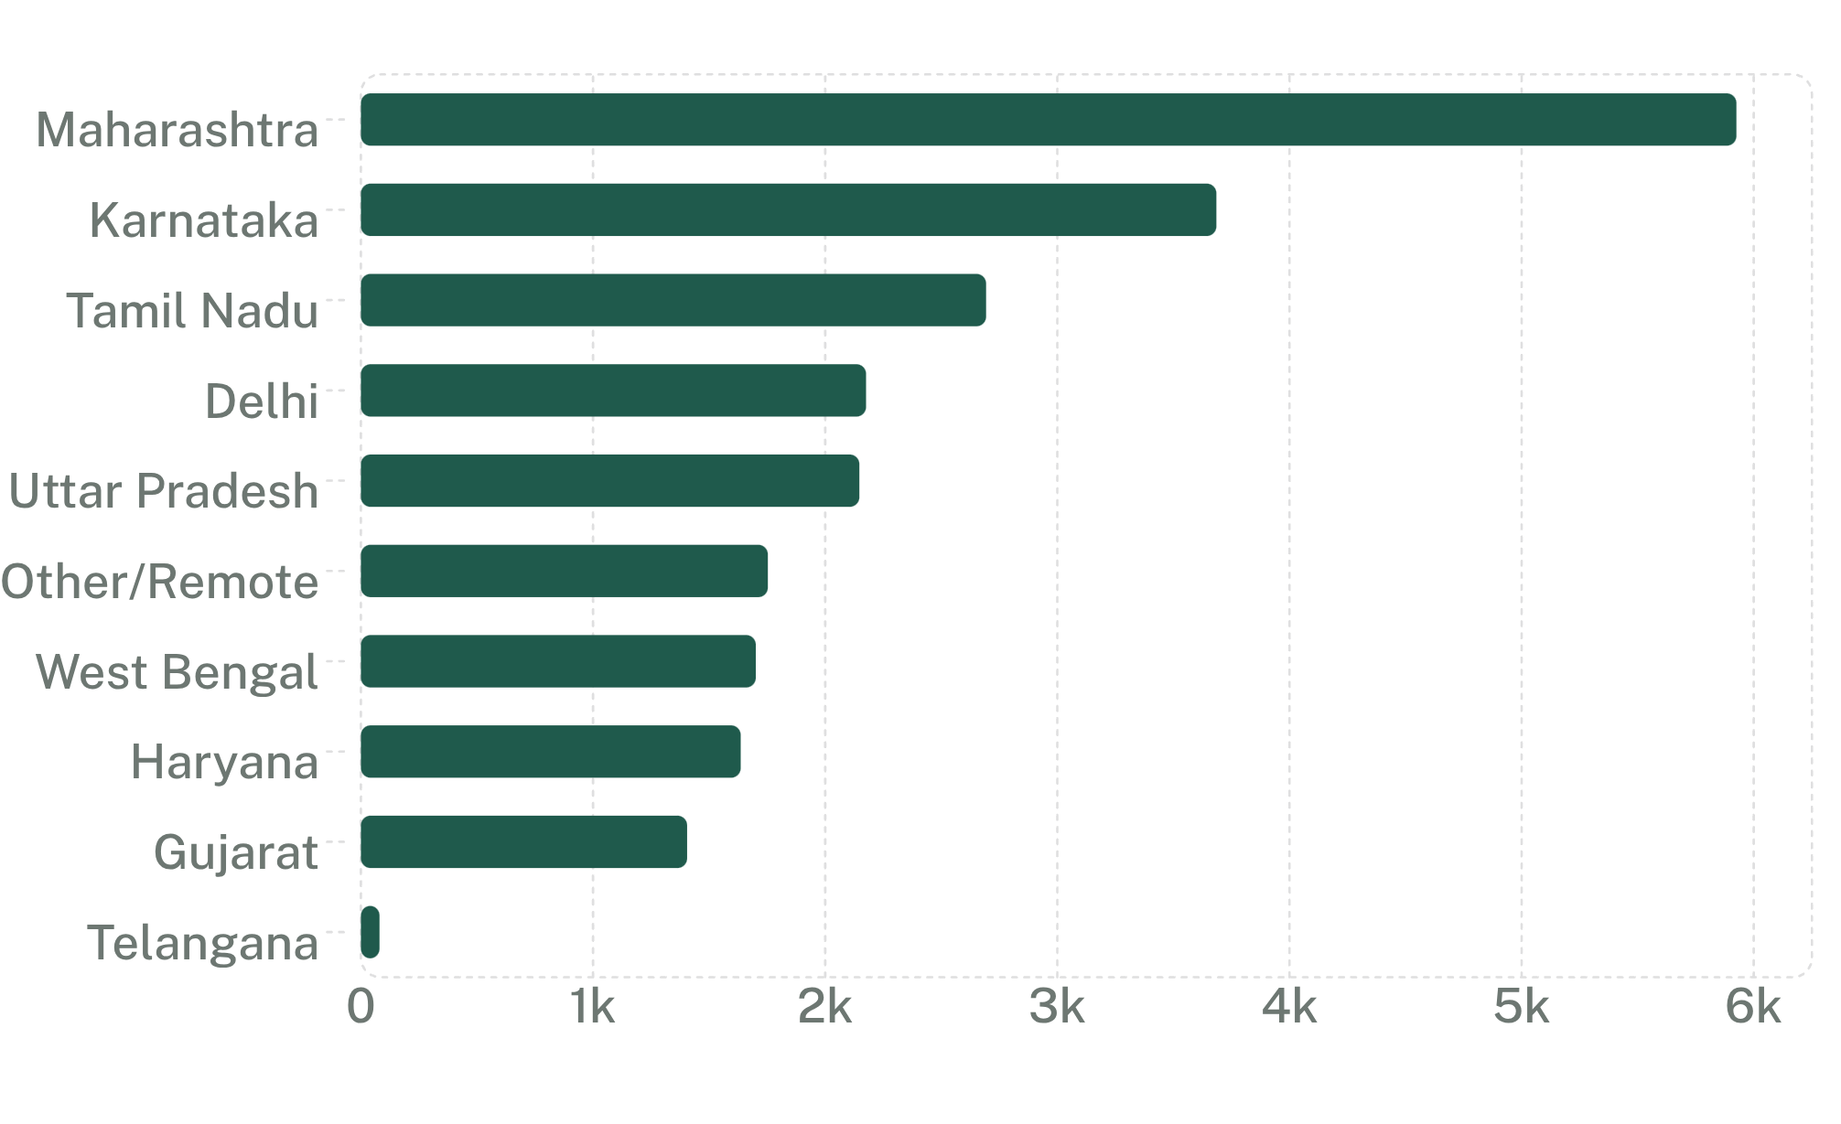
[State Overview]
Maharashtra leads with 5,925 postings, but the map carries scrape-coverage gaps
5,925 · 25.5%
Jobs
Maharashtra combines Mumbai 3,368 and Pune 2,557; avg disclosed LPA is 16.17.
State | Jobs | Share | Avg disclosed LPA
Maharashtra | 5,925 | 25.5% | 16.17
Karnataka | 3,685 | 15.9% | 17.62
Tamil Nadu | 2,693 | 11.6% | 16.58
Delhi | 2,176 | 9.4% | 15.95
Uttar Pradesh | 2,147 | 9.3% | 13.11
Other/Remote | 1,753 | 7.6% | 11.90 (n=63)
West Bengal | 1,701 | 7.3% | 11.17
Haryana | 1,636 | 7.1% | 16.51
Gujarat | 1,405 | 6.1% | 10.38
Telangana | 80 | 0.3% | 13.70 (n=10)
Salary leaders by avg disclosed LPA: Karnataka 17.62, Tamil Nadu 16.58, Maharashtra 16.17.
Low-base salary flags: Other/Remote 11.90 (n=63) and Telangana 13.70 (n=10).
Telangana is represented by Hyderabad only 80 postings (0.3%).
Visual: state table and shape-map proxy bars; fields: state, jobs, share, avg disclosed LPA, salary n flags.
Basis: 23,201-row Power BI model (what the canvas shows) unless marked “(de-dup)”. Source: naukri.com scrape, 10 June 2025.
08

Slide 10
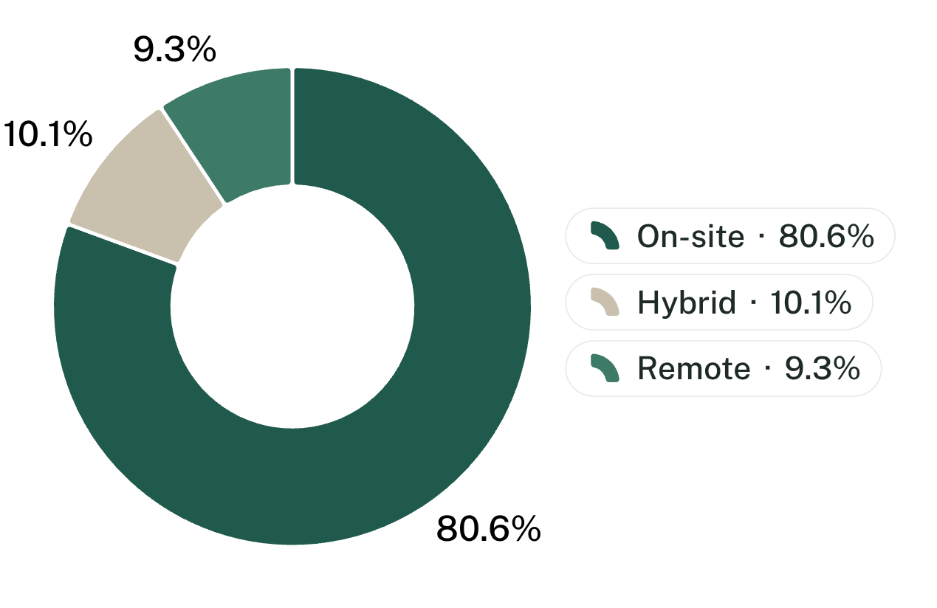
[State Overview]
2,830 postings change city after cleaning, and state mixes are not comparable
2,830 · 12.2%
State | Fresher | Hybrid | Disclosure
Gujarat | 25.9% | 4.3% | 14.0%
West Bengal | 23.7% | [not in source] | [not in source]
Uttar Pradesh | 21.6% | [not in source] | [not in source]
Karnataka | 12.3% | 15.1% | [not in source]
Telangana | 11.2% | [not in source] | [not in source]
Tamil Nadu | [not in source] | 14.2% | 14.1%
Other/Remote | [not in source] | [not in source] | 3.6%
primary_city differs from scraped_city; 473 postings carry a primary_city outside the 11 scrape cities.
1,563
distinct raw location strings
Work mode
27.8%
multi-valued locations (6,455)
198
primary_city values vs 11 scrape cities
Work mode share of postings; Hybrid premium appears on Slide 5.
Cleaning removes locality suffixes and standardizes names such as “Pune(Baner)”, “Mumbai Suburban”, Hubli, and Panipat.
A5: 49.1% (11,386) sit in the capped “3+ weeks ago” bucket; 324 are future-start postings.
State fresher, hybrid, and disclosure shares come from different cells in the source; blank cells are marked [not in source].
Visual: city-cleaning ledger, work-mode donut, and state mix table; fields: raw strings, multi-valued share, primary_city, work mode, fresher share, hybrid share, disclosure share.
Basis: 23,201-row Power BI model (what the canvas shows) unless marked “(de-dup)”. Source: naukri.com scrape, 10 June 2025.
09

Slide 11
[All pillars]
Close the 52-row reconciliation and fix parsing before executive use
ANOMALY REGISTER
ID | Where it hits | Source fact
A1 | Experience / fresher KPI | 822 rows start at 10 yrs yet code min = 0; corrected FFR 14.46% vs 18.03%
A2 | State overview | Hyderabad 80 vs Bangalore 3,685; Telangana salary n=10
A3 | Company size | EY 340, Photon 193, Nagarro 90 bucketed Small/Startup; Mid has 65 rows
A4 | Salary KPIs | Only n=2,768 disclosed (11.93%); mean 15.32 > median 14.0
A5 | Recency | 49.1% capped “3+ weeks ago”; 324 future-start postings
A6 | Skills / employers | Skill lists capped at 8 for 89.8%; “Leading Client” ranks #4
A7 | Integrity | 63 rows salary-disclosed yet tiered “Undisclosed”; role_category mislabels exist
Methodology ask for professors: document de-dup, parsing, salary derivation, and heuristics as model contracts.
Executive ask for industry: use Total Jobs and role mix now; hold salary, fresher, geography, and size-tier decisions until A1-A5 are cleared.
Next build gate: no executive export until the 52-row reconciliation and A1 parser fix are closed.
Basis: 23,201-row Power BI model (what the canvas shows) unless marked “(de-dup)”. Source: naukri.com scrape, 10 June 2025.
10

